Slide 1

RASPBERRY PI WORKSHOP

Slide 2
OUTLINE
SETUP
REMOTE ACCESS
LINUX COMMANDS
PYTHON PROGRAMMING
LEDs
TEMPERATURE
GUI

Slide 3
SETUP

Slide 4
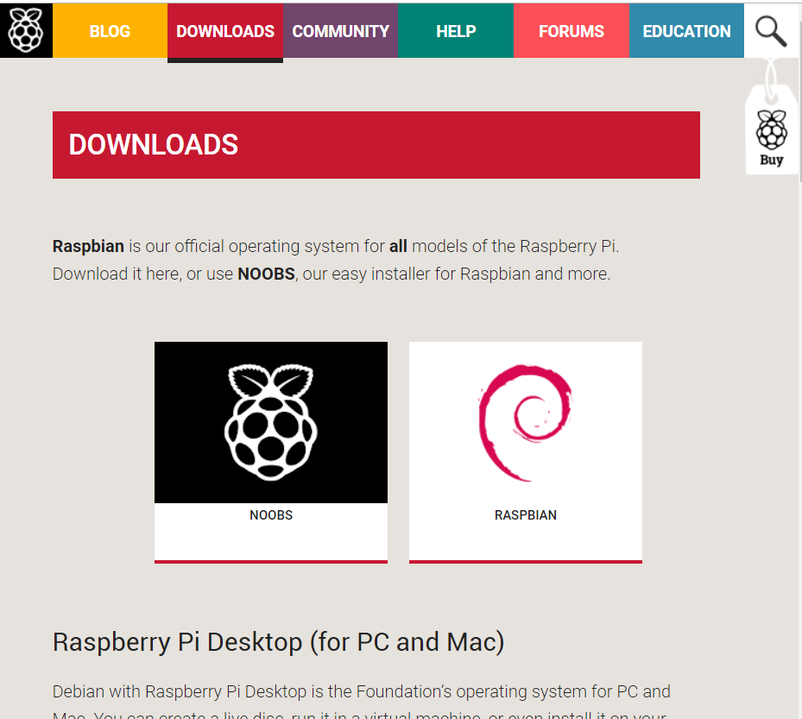
GETTING STARTED
Download Raspbian and Extract Zip Files
https://www.raspberrypi.org/downloads/

Slide 5
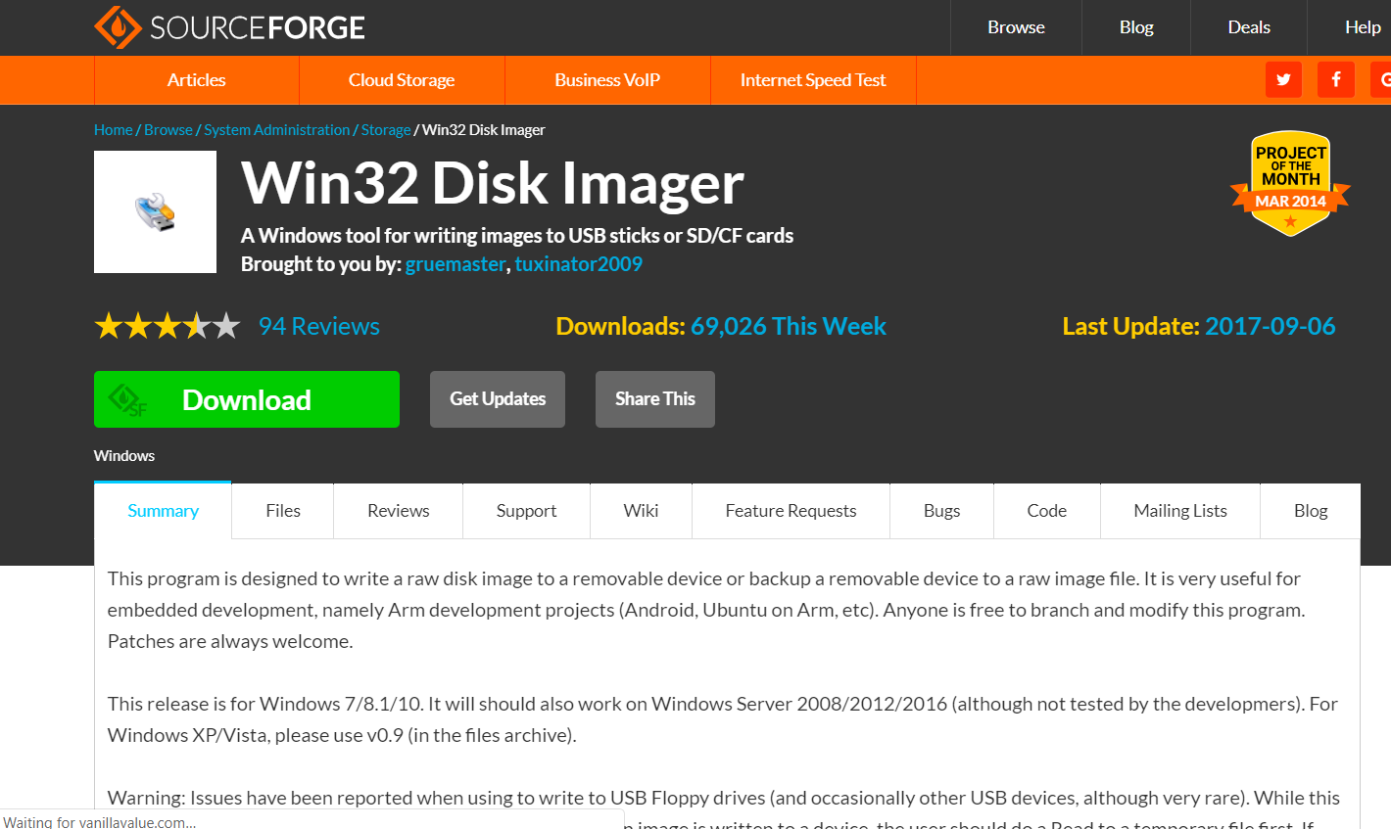
GETTING STARTED
Install win32DiskImager
https://sourceforge.net/projects/win32diskimager

Slide 6
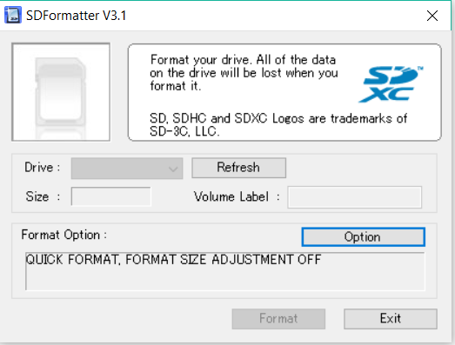
GETTING STARTED
Format SD Card
Panasonic SD Formatter

Slide 7
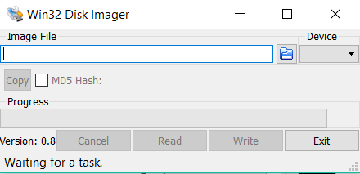
GETTING STARTED
Write image to SD Card
Using win32DiskImager
Click WRITE

Slide 8
GETTING STARTED
Insert SD Card on Raspberry Pi
Access via Direct Setup or Headless Setup
Wait
Finished ☺

Slide 9
REMOTE ACCESS

Slide 10
REMOTE CONNECTION
SSH (Secure Shell)
VNC or REMOTE DESKTOP
ACCESS OVER INTERNET
SFTP (Secure File Transfer Protocol)

Slide 11
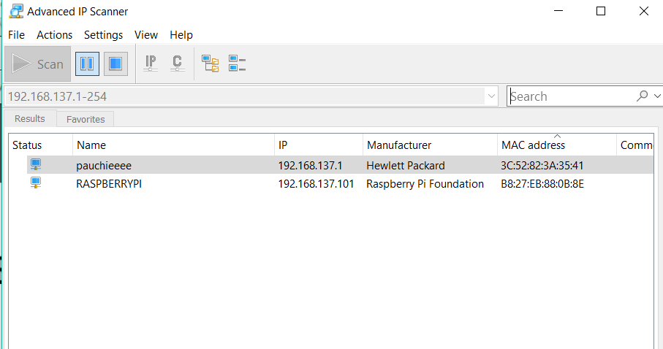
SSH (Secure Shell)
Connect RPi to laptop via Ethernet cable
Use Advanced IP Scanner software to scan IP Address of RPi
https://www.advanced-ip-scanner.com/

Slide 12
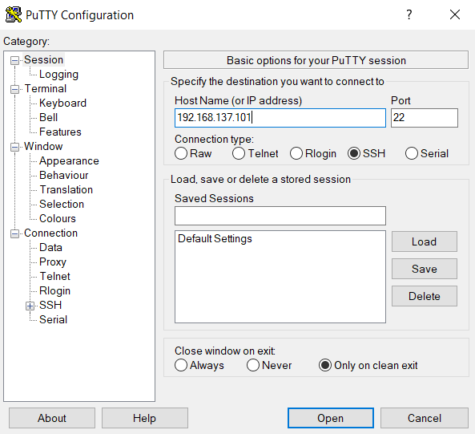
SSH (Secure Shell)
Input IP Address to Putty.

Slide 13
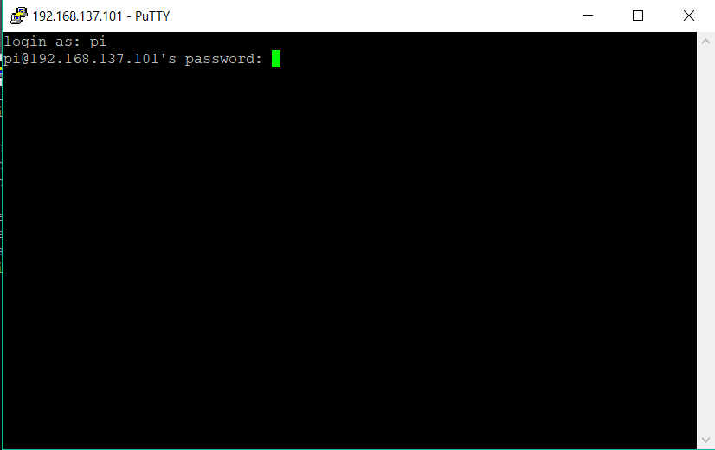
SSH (Secure Shell)
Default:
Login as: pi
Password: raspberry
Click Enter

Slide 14
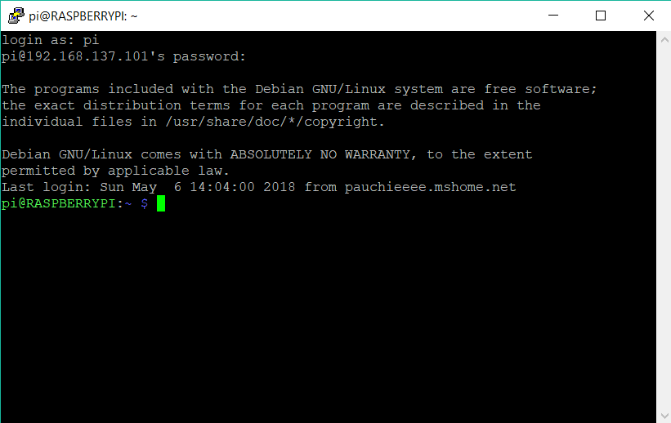
SSH (Secure Shell)
Terminal

Slide 15
VNC or Remote desktop
After connecting to Terminal via Putty (SSH)
Enter to Terminal:
sudo apt-get install xrdp (remote desktop)
sudo apt-get install realvnc-vnc-viewer (VNC – Virtual Network Computing)

Slide 16
VNC or Remote desktop
Run the command:
sudo raspi-config, navigate to: Advanced Options > VNC > select Yes
By default, VNC Server remotes the graphical desktop running on your Raspberry Pi.

Slide 17
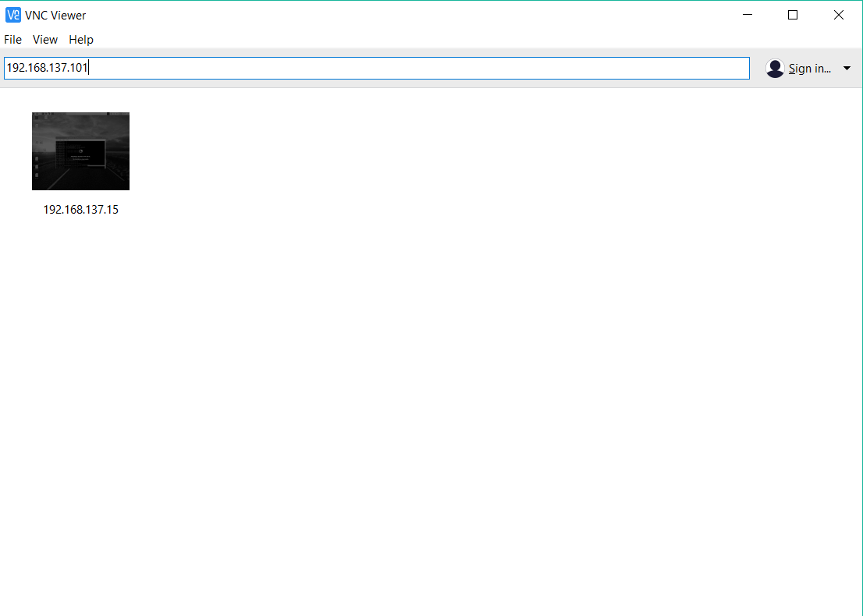
VNC
FOR VNC
IP ADDRESS OF Rpi is required

Slide 18
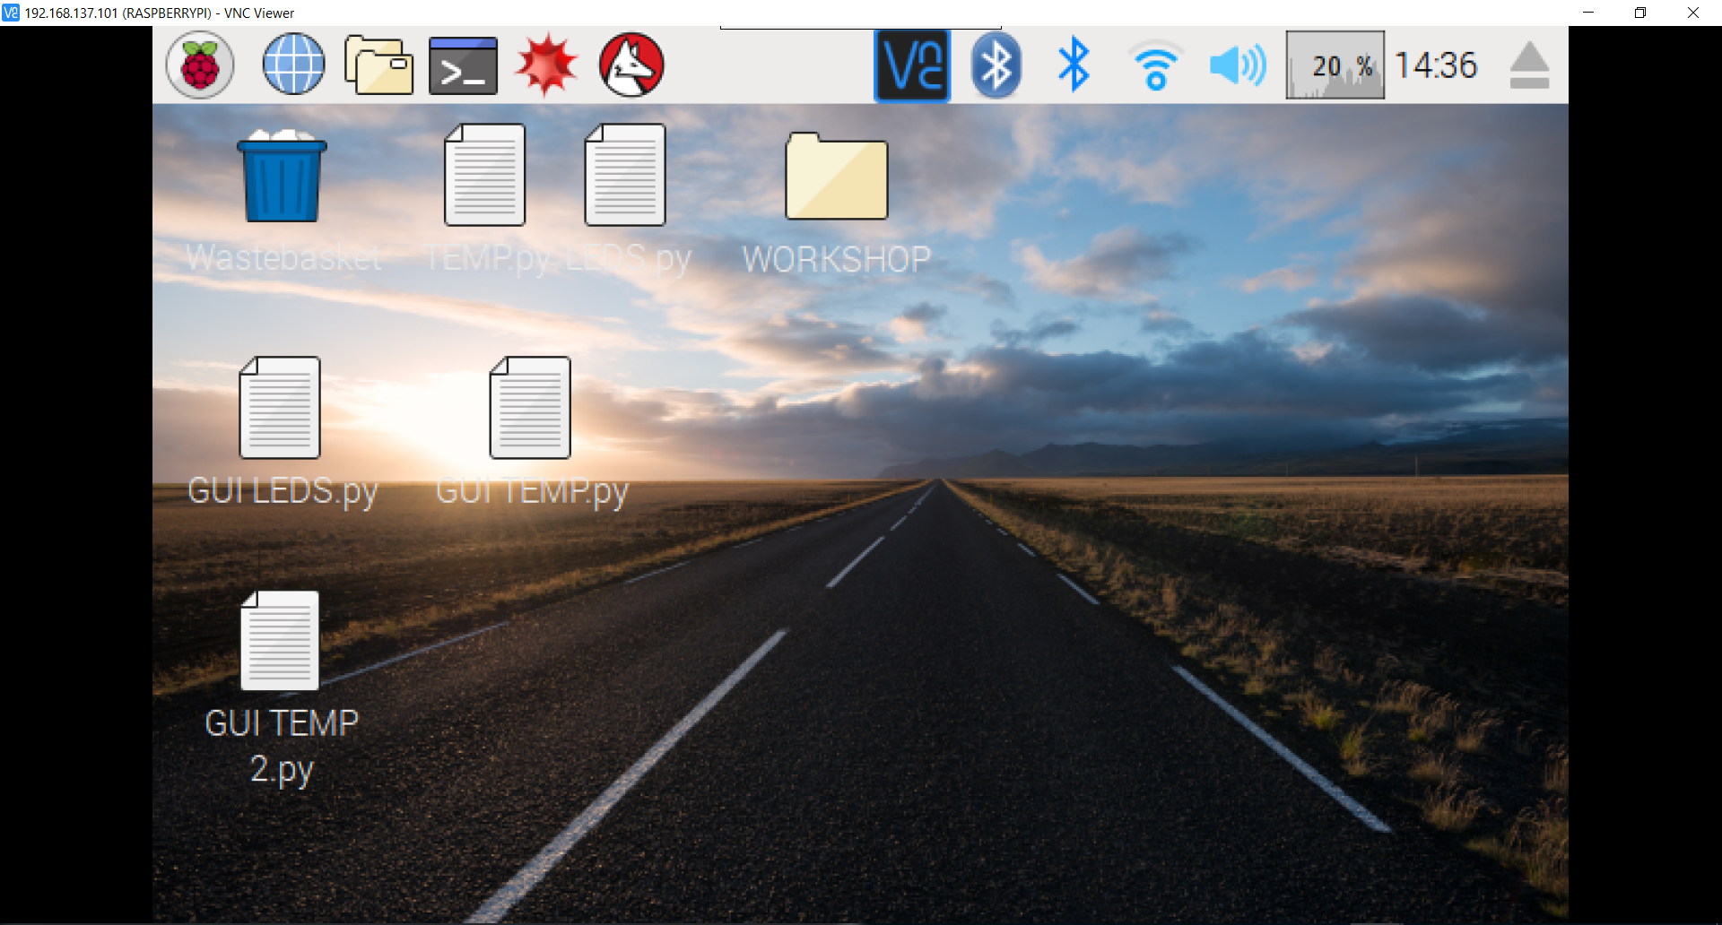

Slide 19
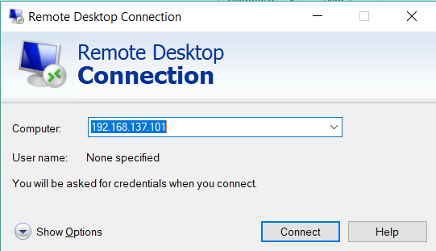
Remote desktop
FOR REMOTE DESKTOP
IP ADDRESS OF Rpi is required
Login as: pi
Password: raspberry

Slide 20
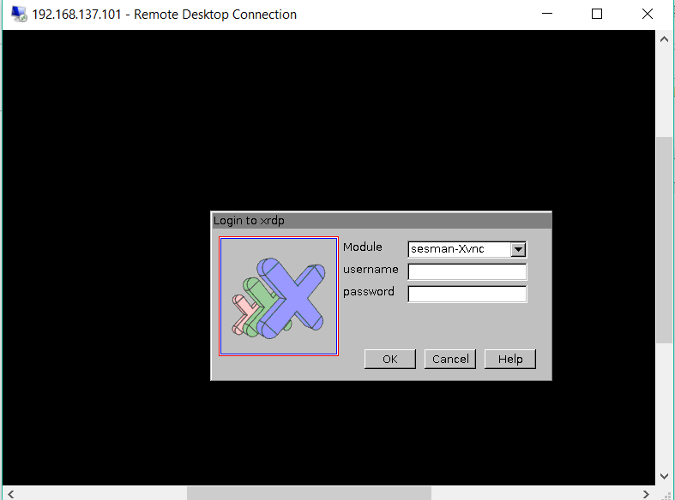
Remote desktop
Username: pi
Password: raspberry

Slide 21
VNC or Remote desktop
Username: pi
Password: raspberry

Slide 22
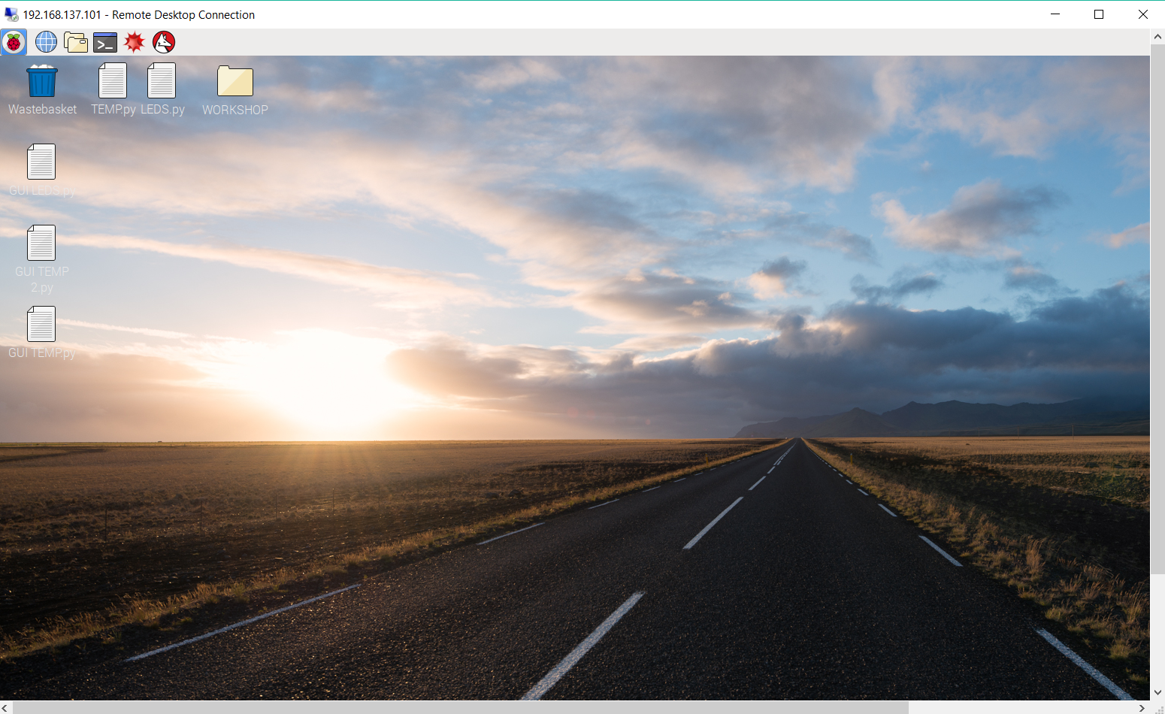

Slide 23
ACCESS OVER INTERNET
On laptop: got to Apps & Features
Manage Optional Features
Install OpenSSH Client (Beta)
Install OpenSSH Server (Beta)

Slide 24
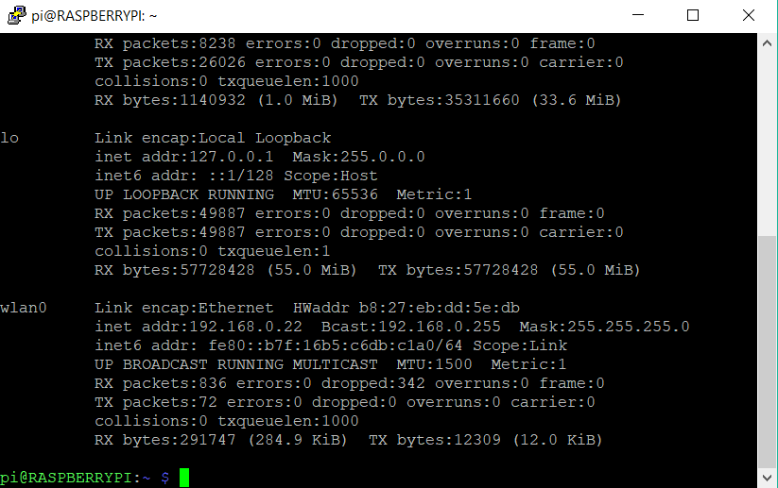
ACCESS OVER INTERNET
On Terminal:
Run ifconfig

Slide 25
ACCESS OVER INTERNET
On Terminal:
Use the IP Address to Putty or VNC or Remote Desktop
Remove Ethernet Cable

Slide 26
SFTP
SSH File Transfer Protocol
Extension of the SSH to handle file transfers
Programs
FileZilla, WinSCP

Slide 27
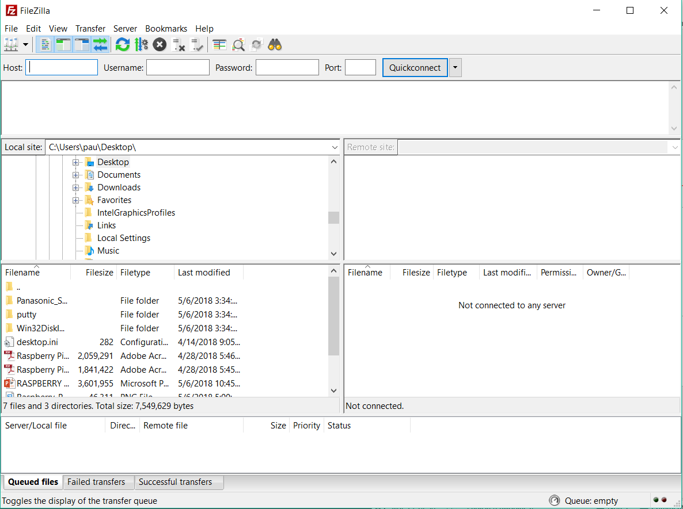
SFTP - Filezilla

Slide 28
ACTIVITY

Slide 29
ACTIVITY (SFTP)
On your Desktop:
Create a file.txt and rename the file.
Download the mp4 file to your Desktop
Transfer the 2 files to your Rpi Desktop

Slide 30
Linux commands

Slide 31
GENERAL COMMANDS
clear
Clears previously run commands and text from the terminal screen.
Date
Prints the current date.
find / -name example.txt
Searches the whole system for the file example.txt and outputs a list of all directories that contain the file.
nano example.txt
Opens the file example.txt in the Linux text editor Nano.

Slide 32
GENERAL COMMANDS
sudo raspi-config
Opens the configuration settings menu.

Slide 33
FILE AND DIRECTORY COMMANDS
cat example.txt
Displays the contents of the file example.txt.
cd /abc/xyz
Changes the current directory to the /abc/xyz directory.
cp XXX:
Copies the file or directory XXX
mv XXX
Moves the file or directory named XXX to a specified location.
Notes:
CP
and pastes it to a specified location; i.e. cp examplefile.txt /home/pi/office/ copies examplefile.txt in the current directory and pastes it into the /home/pi/ directory. If the file is not in the current directory, add the path of the file’s location (i.e. cp /home/pi/documents/examplefile.txt /home/pi/office/ copies the file from the documents directory to the office directory).
MV
For example, mv examplefile.txt /home/pi/office/ moves examplefile.txt in the current directory to the /home/pi/office directory. If the file is not in the current directory, add the path of the file’s location (i.e. cp /home/pi/documents/examplefile.txt /home/pi/office/ moves the file from the documents directory to the office directory). This command can also be used to rename files (but only within the same directory). For example, mv examplefile.txt newfile.txtrenames examplefile.txt to newfile.txt, and keeps it in the same directory.

Slide 34
FILE AND DIRECTORY COMMANDS
rm example.txt
Deletes the file example.txt.
rmdir example_directory
Deletes the directory example_directory (only if it is empty).
scp user@10.0.0.32:/some/path/file.txt
Copies a file over SSH..
touch example.txt
Creates a new, empty file named example.txt in the current directory.
Notes:
SCP
Can be used to download a file from a PC to the Raspberry Pi. user@10.0.0.32 is the username and local IP address of the PC, and /some/path/file.txt is the path and file name of the file on the PC.

Slide 35
NETWORKING AND INTERNET COMMANDS
ifconfig
To check the status of the wireless connection you are using (to see if wlan0 has acquired an IP address).
iwconfig
To check which network the wireless adapter is using.
iwlist wlan0 scan
Prints a list of the currently available wireless networks.

Slide 36
NETWORKING AND INTERNET COMMANDS
nmap
Scans your network and lists connected devices, port number, protocol, state (open or closed) operating system, MAC addresses, and other information.
ping
Tests connectivity between two devices connected on a network. For example, ping 10.0.0.32 will send a packet to the device at IP 10.0.0.32 and wait for a response. It also works with website addresses.
wget http://www.website.com/example.txt
Downloads the file example.txt from the web and saves it to the current directory.

Slide 37
SYSTEM INFORMATION COMMANDS
cat /proc/meminfo
Shows details about your memory.
cat /proc/partitions
Shows the size and number of partitions on your SD card or hard drive.
cat /proc/version
Shows you which version of the Raspberry Pi you are using.
df –h
Shows information about the available disk space.

Slide 38
SYSTEM INFORMATION COMMANDS
df /
Shows how much free disk space is available.
dpkg – –get–selections
Shows all of your installed packages.
free
Shows how much free memory is available.
hostname –I
Shows the IP address of your Raspberry Pi.
lsusb
Lists USB hardware connected to your Raspberry Pi.

Slide 39
SYSTEM INFORMATION COMMANDS
PRESS UP KEY
print the last command entered into the command prompt. This is a quick way to repeat previous commands or make corrections to commands.
vcgencmd measure_temp
Shows the temperature of the CPU.
vcgencmd get_mem arm && vcgencmd get_mem gpu
Shows the memory split between the CPU and GPU.

Slide 40
Linux Commands
SHUTDOWN
sudo halt
REBOOT
sudo reboot

Slide 41
NEVER RUN THIS COMMAND
rm –rf/

Slide 42
Updating raspian os
sudo apt-get update
Synchronizes the list of packages on your system to the list in the repositories. Use it before installing new packages to make sure you are installing the latest version.sudo
sudo apt-get upgrade
Upgrades all of the software packages you have installed.

Slide 43
PyTHON PROGRAMMING

Slide 44

LEDs

Slide 45
BLINKING AN LED THROUGH GPIO PINS

Slide 46
Objectives
Familiarization to Rpi’s GPIO Pins
Turning ON the LED
Blinking an LED

Slide 47
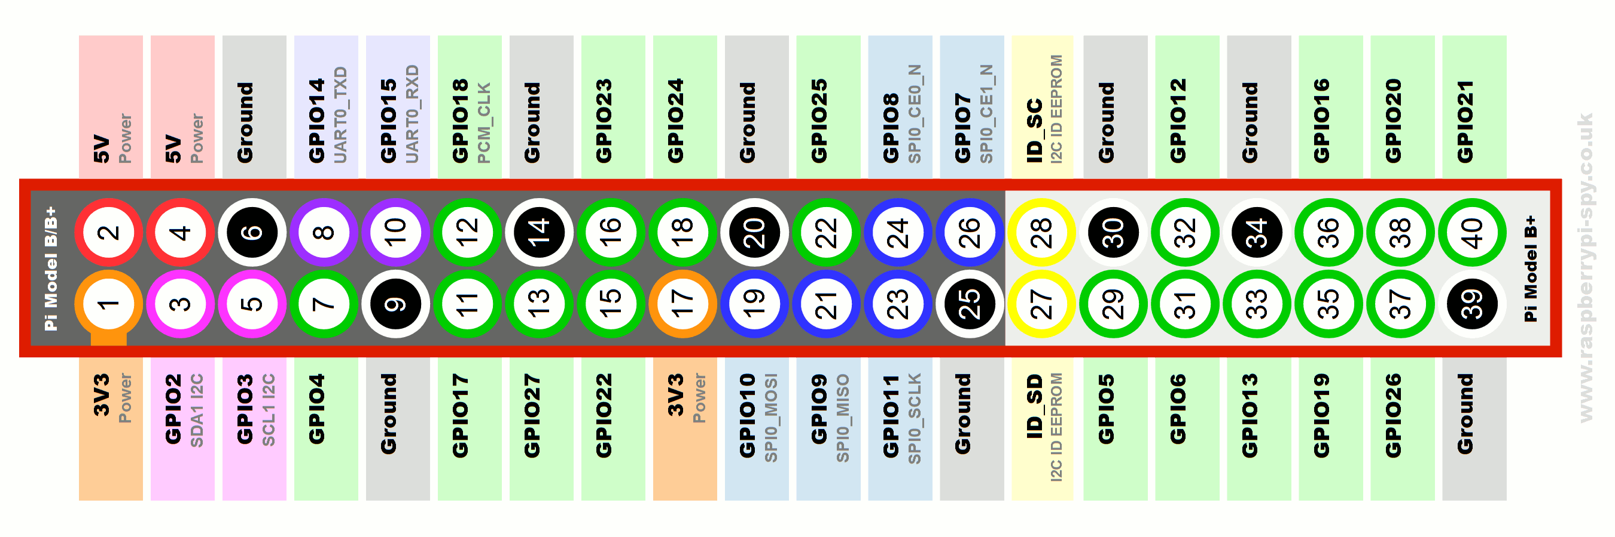
Familiarization to Rpi’s GPIO Pins

Slide 48
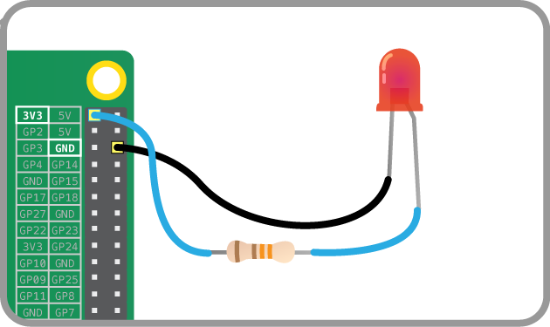
Turning ON the LED – Testing

Slide 49

Turning ON the LED – Hardware

Slide 50
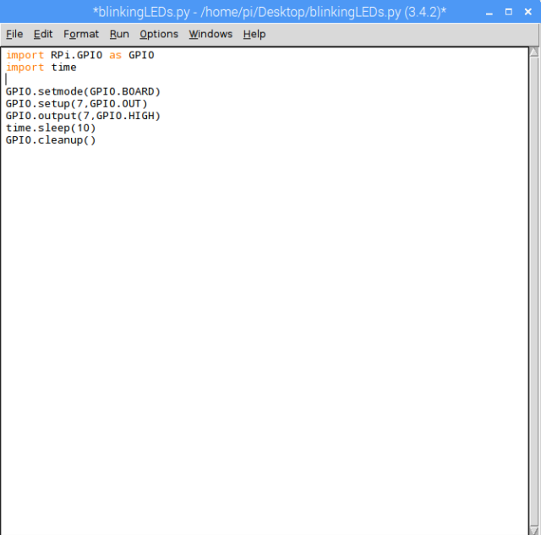
Turning ON the LED – Software

Slide 51
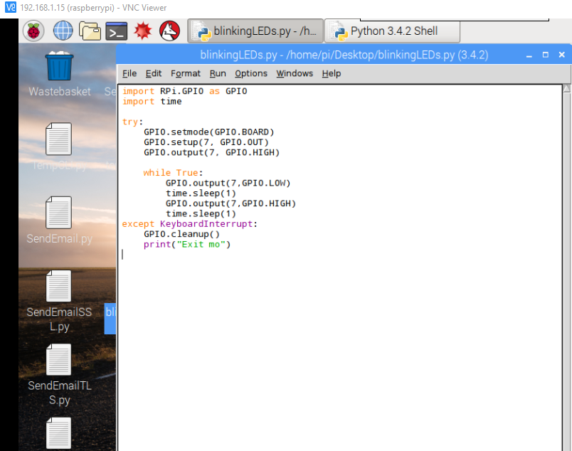
Blinking an LED

Slide 52

Raspberry pi Web server

Slide 53
Web server
A program that uses HTTP to serve the files that form Web Pages to users
In Python, the Flask web-framework is used as a web server
The Flask library is built-in
The Flask library is used to access the GPIO PINS via Web Server

Slide 54
HARDWARE

Slide 55
steps
sudo python app.py
Determine the IP Address of your Raspberry Pi
Open a web browser (pc, phone, tablet)
Input the IP Address into the web browser
Toggle the ON/OFF Button

Slide 56

Input the IP Address into the web browser

Slide 57
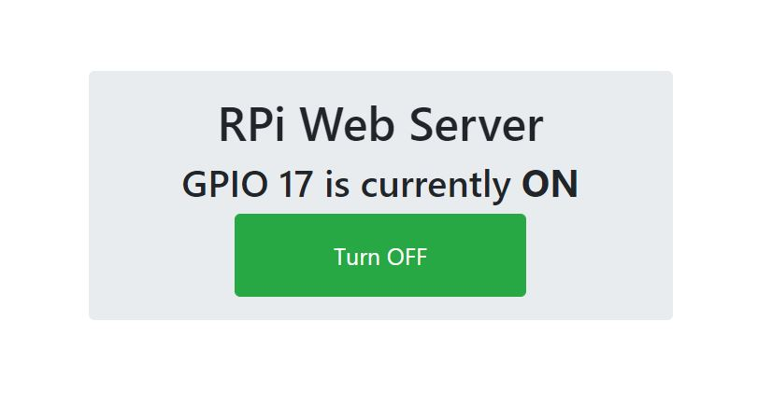
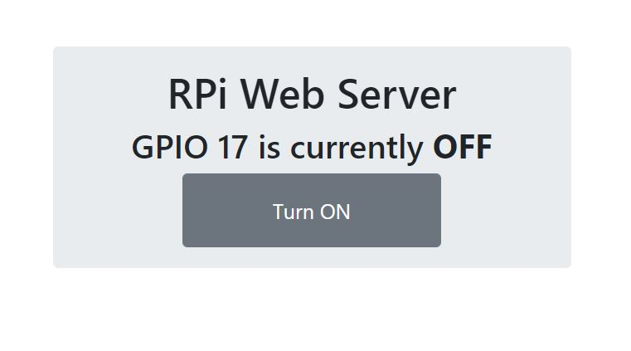
Toggle the ON/OFF Button

Slide 58
CAYENNE

Slide 59
Cayenne
An IoT-based online application platform
Raspberry Pi
Arduino
Drag and Drop
Customizable
Wide range of available sensors
Available in Play Store and Apple Store

Slide 60
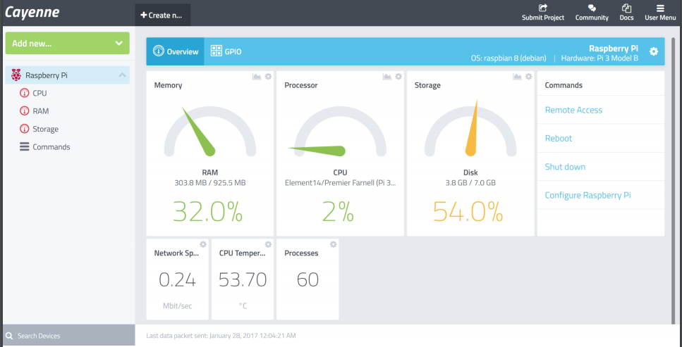
Cayenne Interface (Desktop)

Slide 61
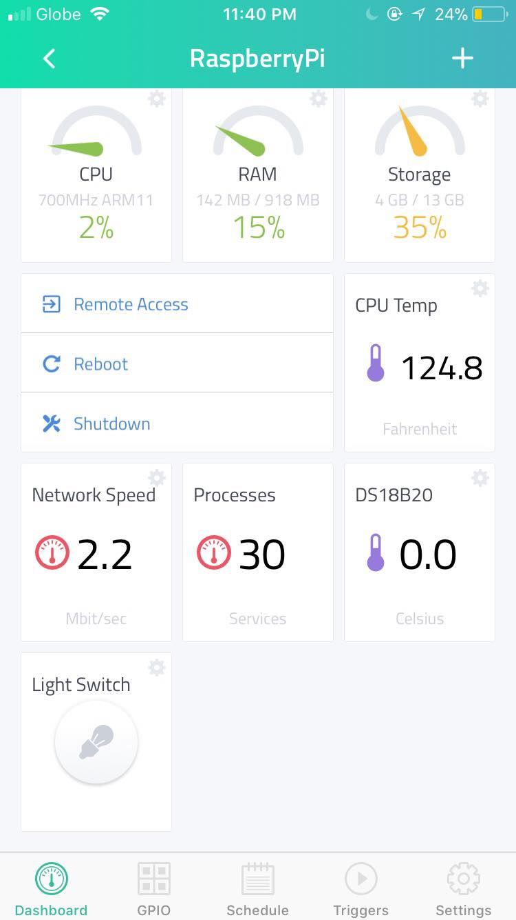
Cayenne Interface (Smartphone)

Slide 62
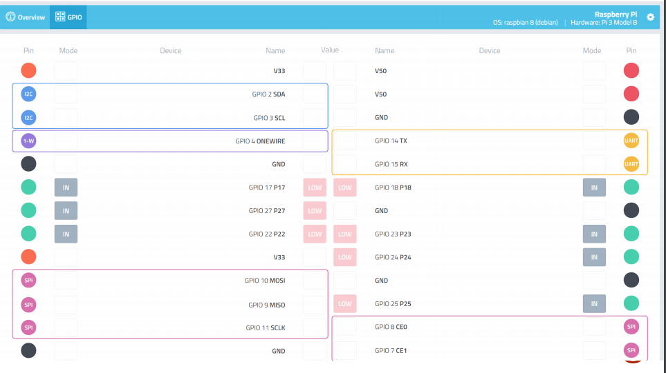
Cayenne Interface (GPIO)

Slide 63
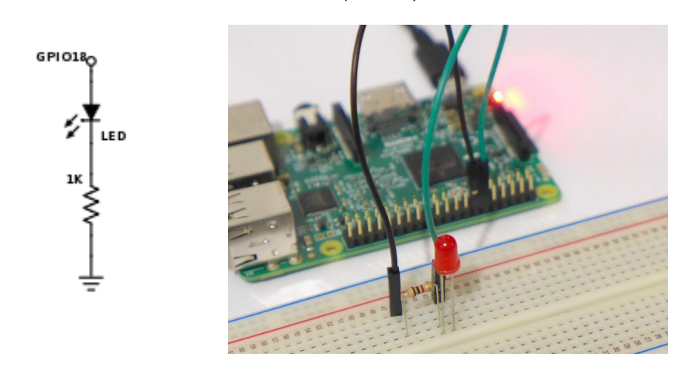
LED Sample

Slide 64
Steps
Install Cayenne on your Android or iPhone
Connect your phone to your Raspberry Pi.
Create account
Add New >>
Device/Widget
Actuators >> Light
Channel 18
Choose Icon >> Light
Add Actuator

Slide 65

Temperature SENSOR

Slide 66
Interfacing Temperature Sensor with Raspberry Pi

Slide 67
Objectives
Setting up the DS18B20 – Digital Temperature Sensor
Temperature monitoring through Python IDLE & CLI.

Slide 68

DS18B20 – Digital Temperature Sensor
DATA
GND
VCC

Slide 69
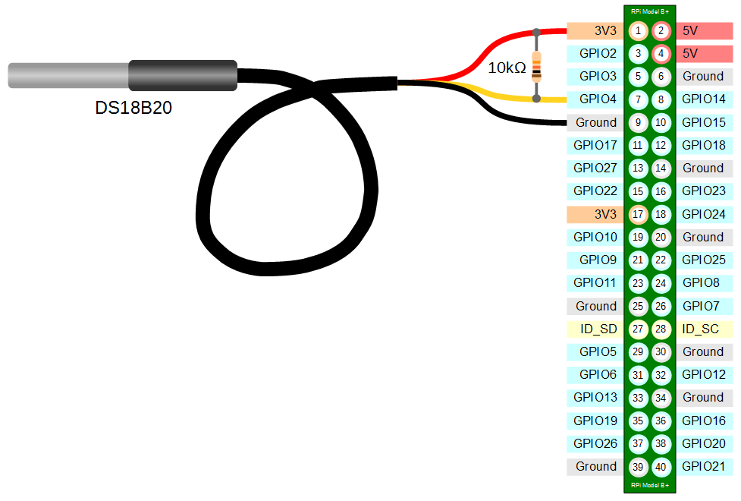
How to connect Temperature Sensor to Raspberry Pi?

Slide 70
Raspberry Pi – Set Up
Add 1-Wire Support
Add module from the Linux Kernel (w1-gpio, and w1-them)
Read the contents of the digital temperature sensor
Install w1thermsensor Python module

Slide 71
Add 1-Wire Support
>>sudo nano /boot/config.txt
Add the following: dtoverlay=w1-gpio
Reboot the RPi

Slide 72
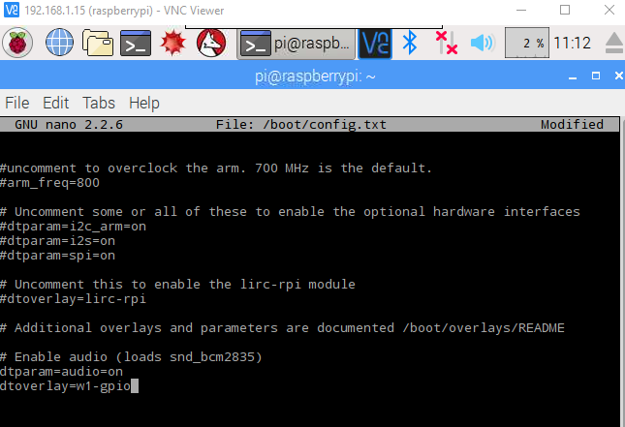

Slide 73
Add module from the Linux Kernel
>>sudo modprobe w1-gpio
>>sudo modprobe w1-therm

Slide 74
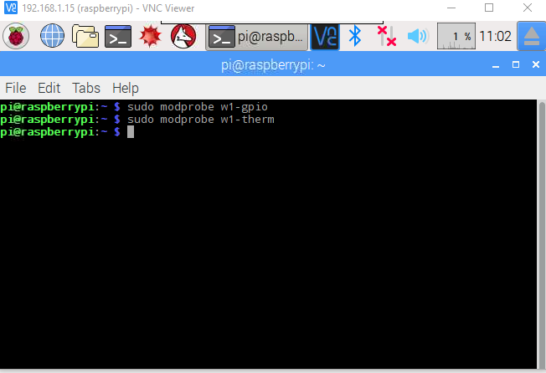

Slide 75
Read the contents of the digital temperature sensor
>>cd /sys/bus/w1/devices
>>ls
>>cd 28-nnnnnn
>> cat w1_slave

Slide 76
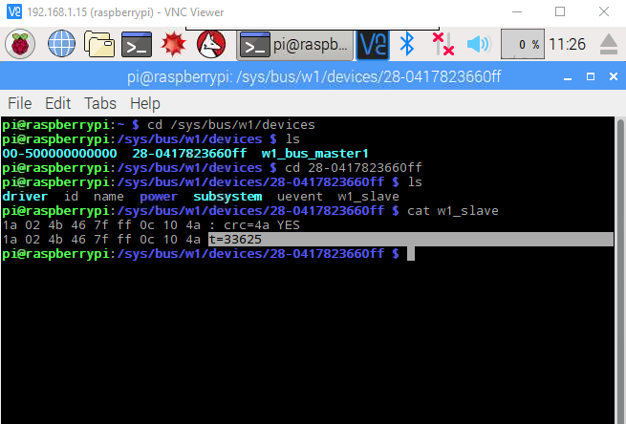
Current Temperature Reading

Slide 77
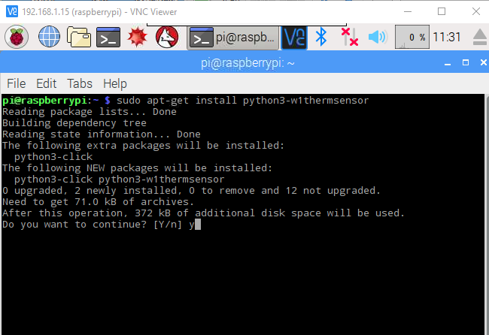
Install w1thermsensor Python module

Slide 78
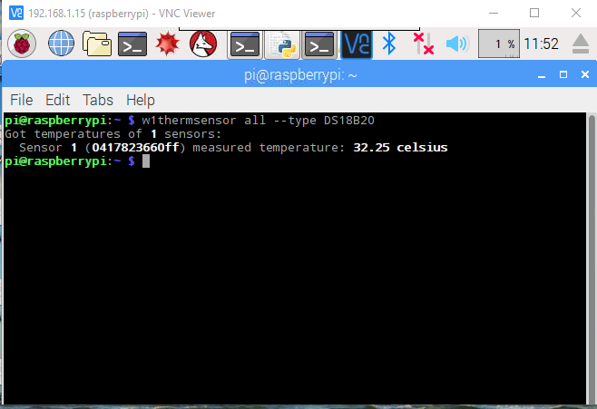
Temperature Monitoring through CLI

Slide 79
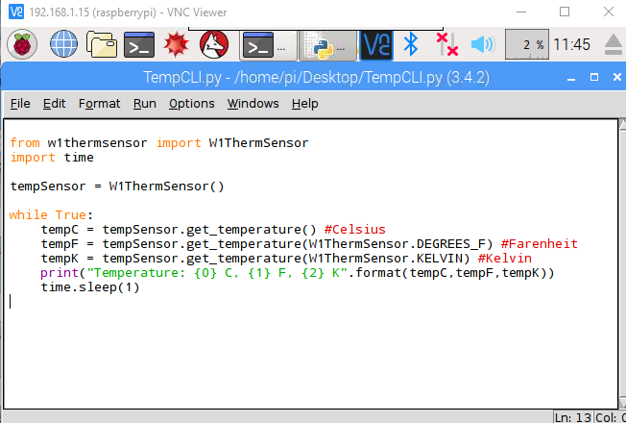
Temperature monitoring through Python IDLE

Slide 80
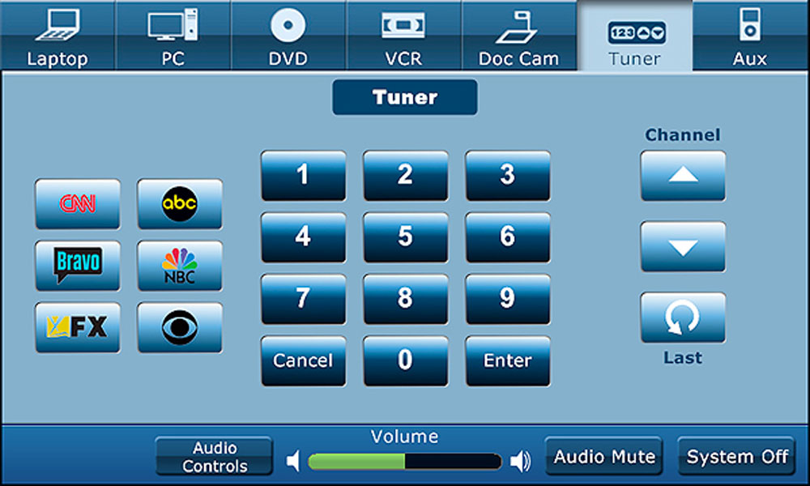
GRAPHICAL USER INTERFACE

Slide 81
TK-INTER PYTHON GUI PROGRAMMING

Slide 82
Objectives
Introduce Tkinter – a python GUI module
Create an empty window using Tkinter
Customizing your window
Adding widgets to your window
Customizing the added widgets
Button – Callback Functions
Display sensor data through GUI

Slide 83
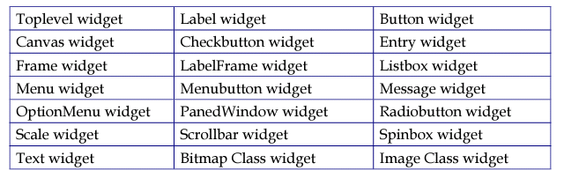
Introduce Tkinter – a python GUI module
It is the standard GUI Module for Python. It provides a power object-oriented interface to the TK GUI toolkit
Supported widgets of Tkinter

Slide 84
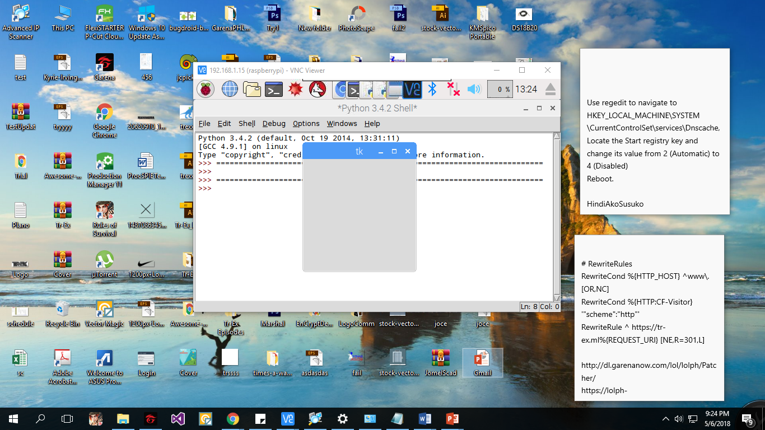
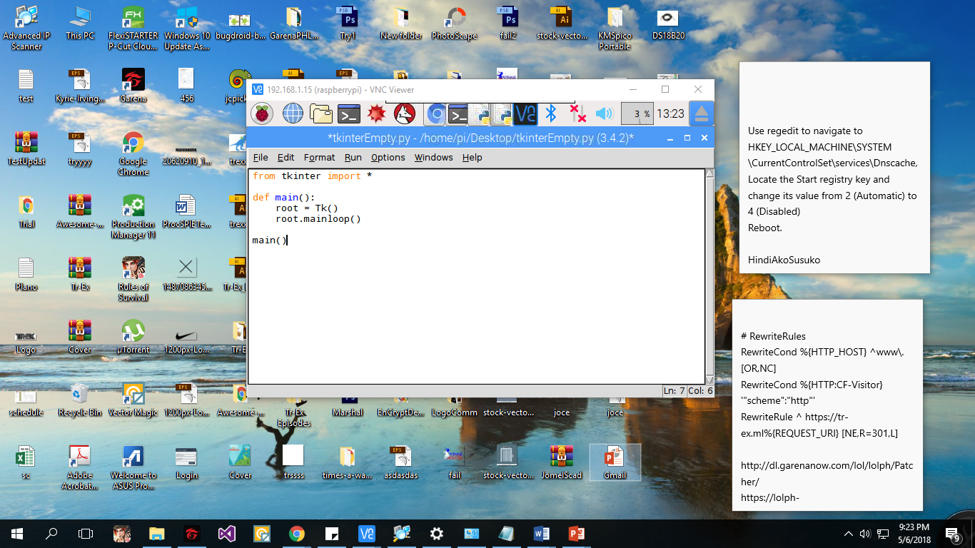
Create an empty window using Tkinter
Empty Window

Slide 85
Customizing your window
Changing window title
Changing window size
Changing window color

Slide 86
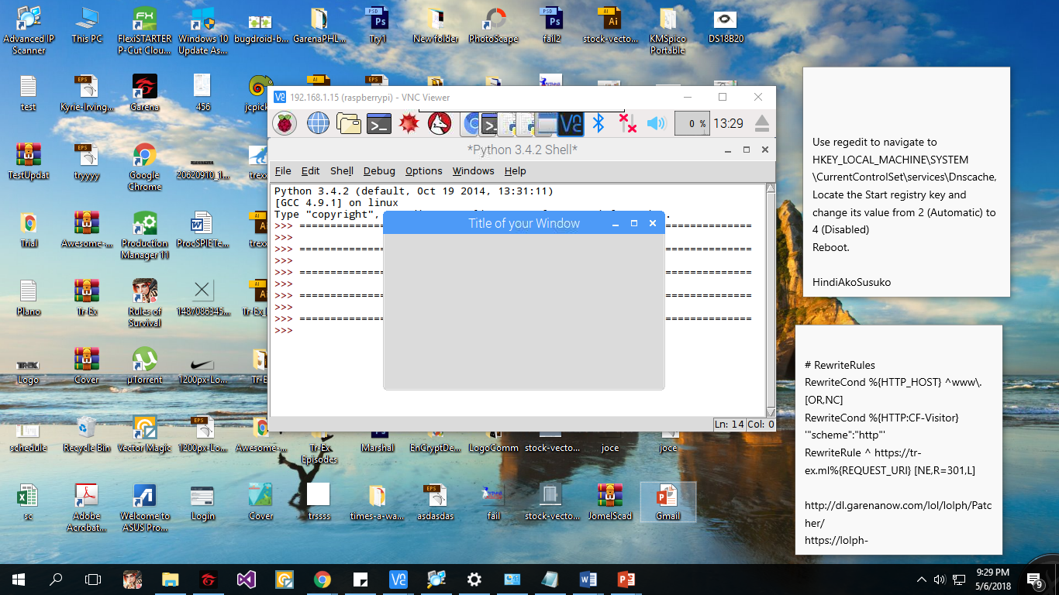
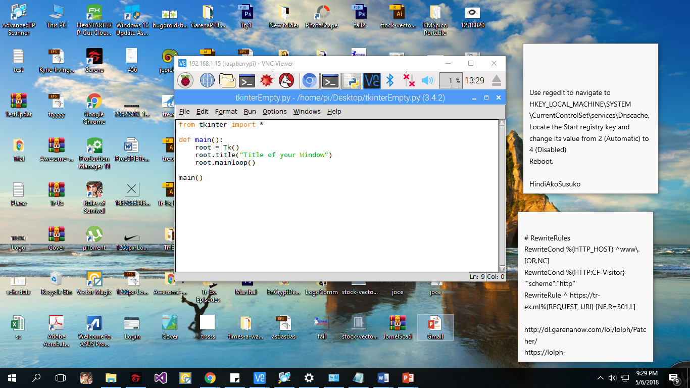
To change window title

Slide 87
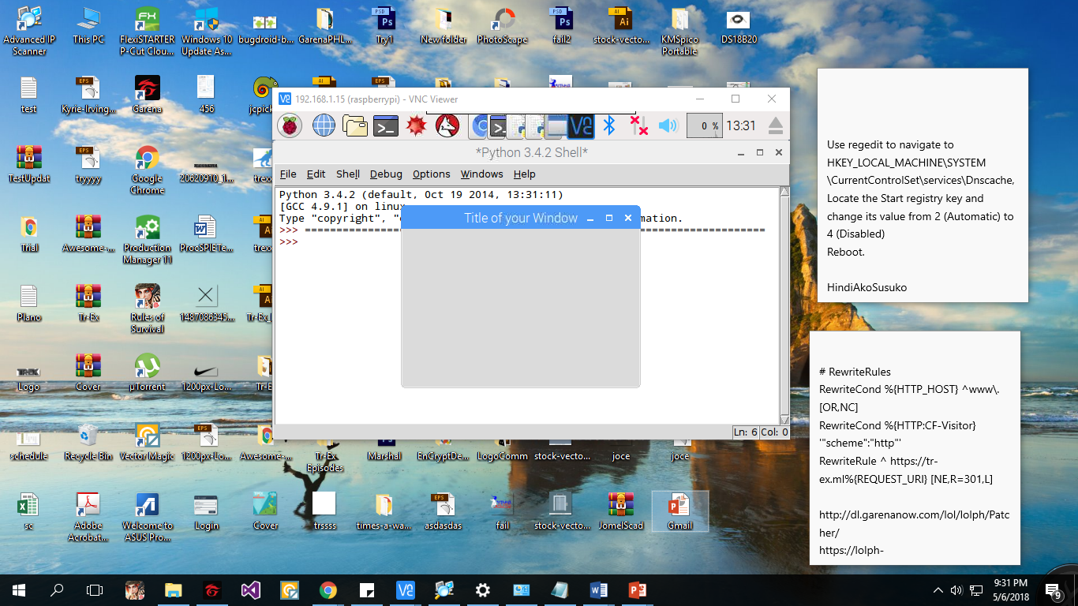
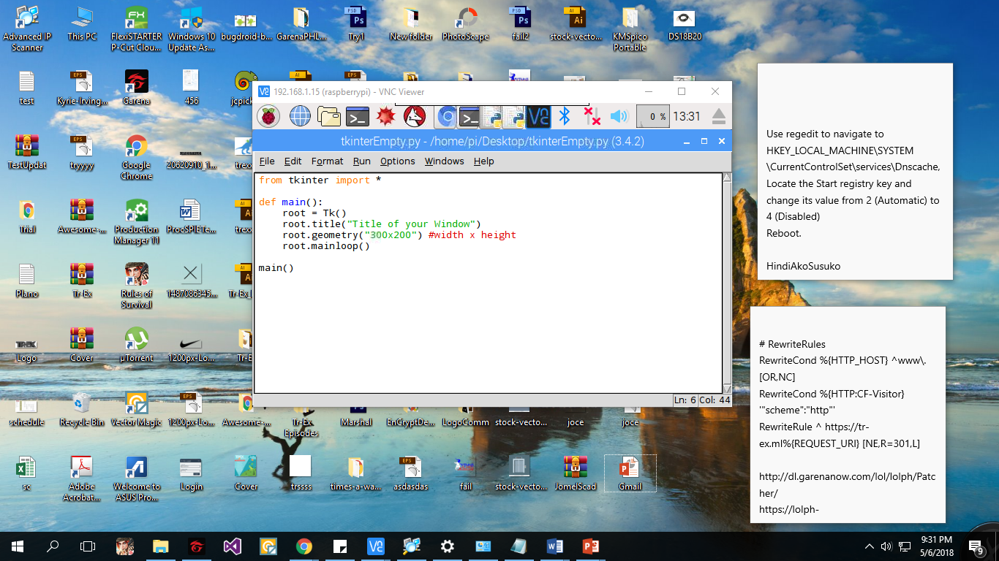
To change window size

Slide 88
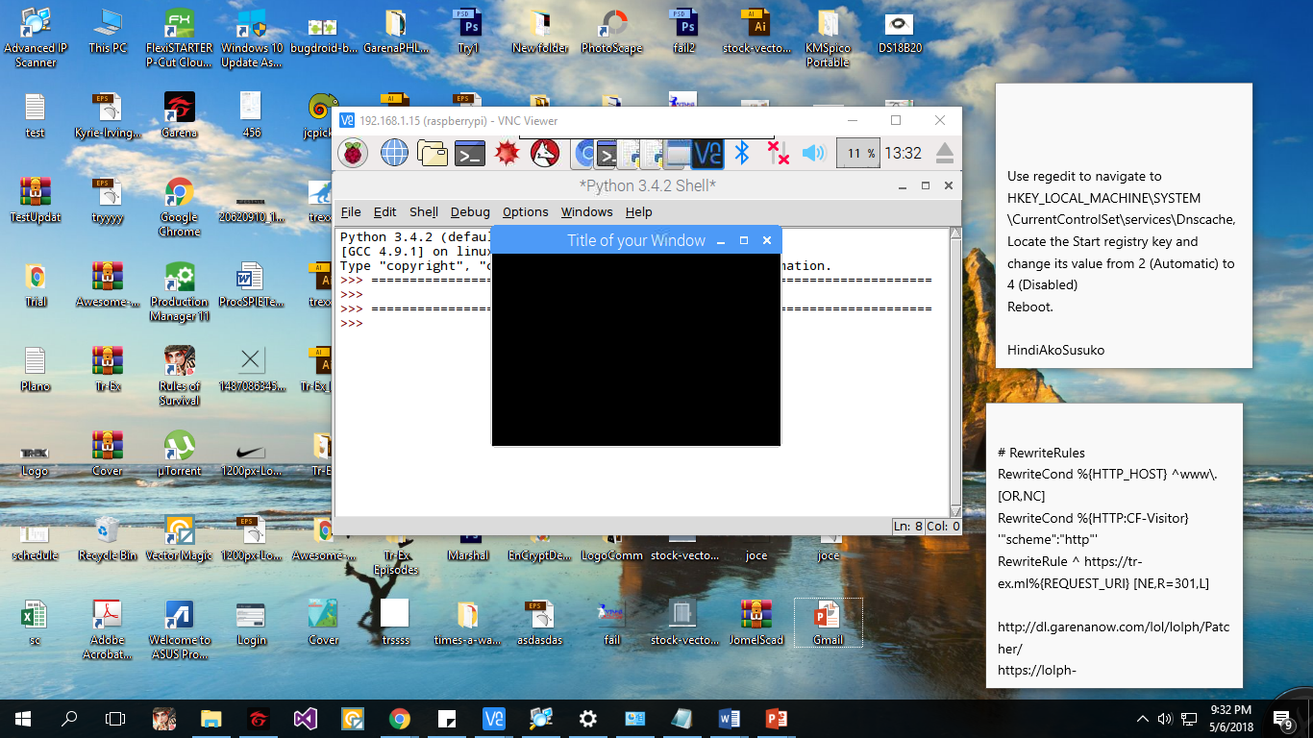

To change window color

Slide 89
Adding widgets to your window
Syntax used to add widgets:
my_widget = Widget-name(its container, ** its configuration options)
Widgets we will be using

Slide 90

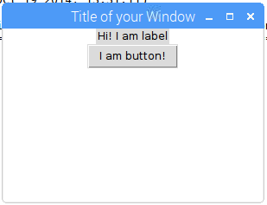
Adding widgets to your window

Slide 91
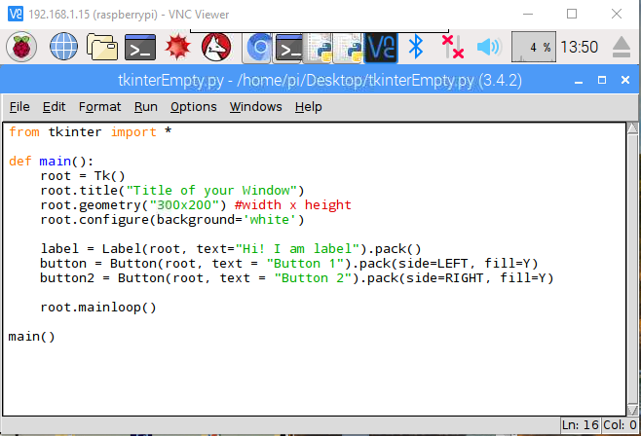
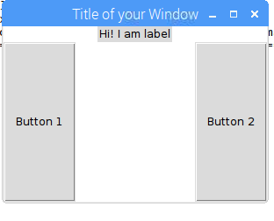
Customizing the added Widgets

Slide 92
Button – Callback Functions
A callback function is a function that is executed when the user pressed a button

Slide 93
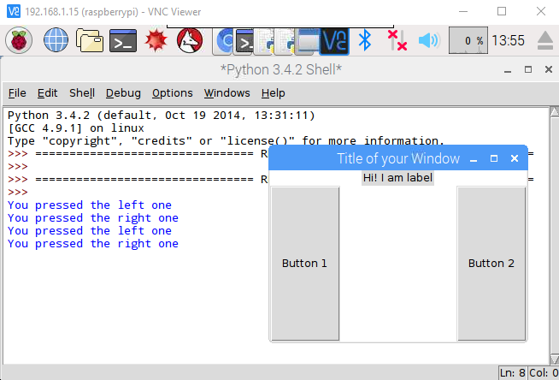
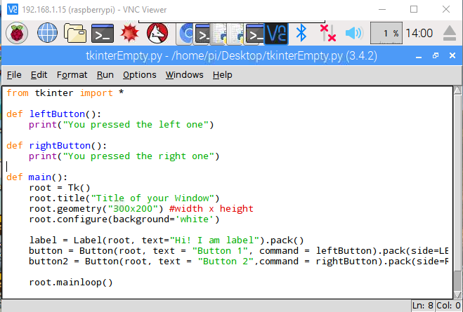

Slide 94
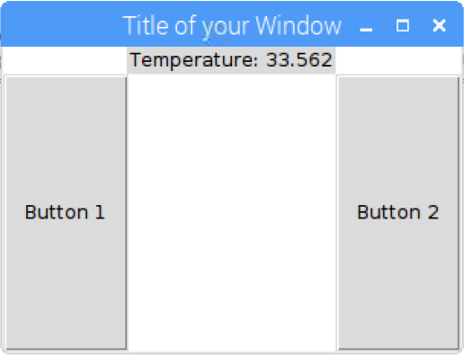
Display sensor data through GUI

Slide 95
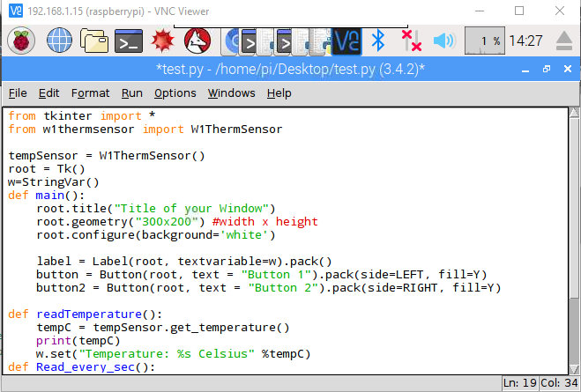

Slide 96
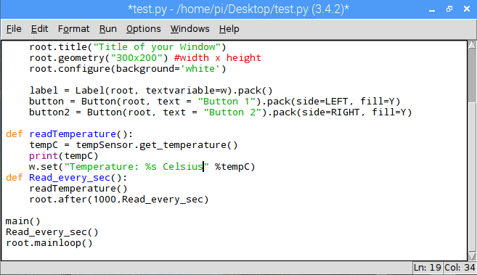

Slide 97
EXERCISES

Slide 98
Exercises
Create a program that will automatically email iecep.raspberry@gmail.com when the temperature reach a certain set point.
Create a program that will turn ON the LED whenever the user push button 1, and will turn OFF the LED when button 2 is pressed.

Slide 99
Exercise (CAYENNE)
Connect your digital temperature sensor
Determine your 1-Wire Address
Channel 4

